Slide 1
Lecture 2
Benefits of Cloud Computing
Instructor : Engr. Tehmeed

Slide 2
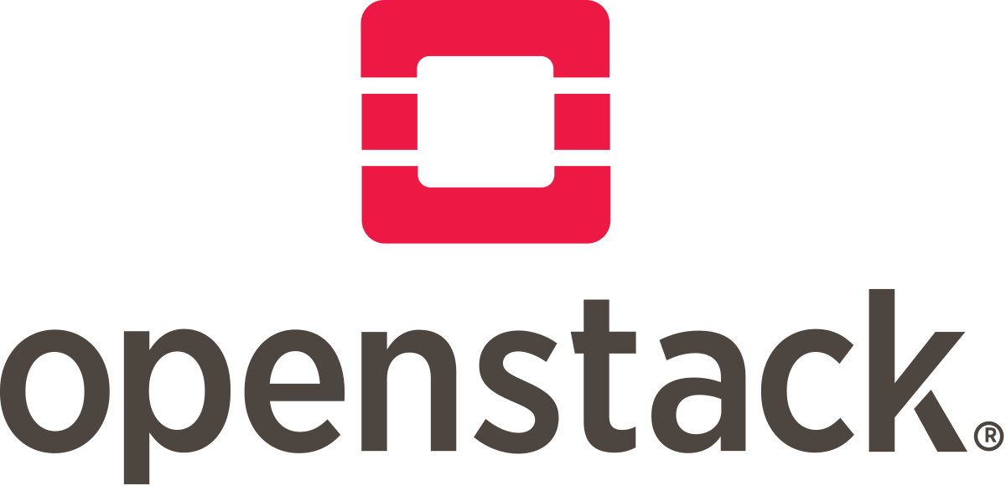
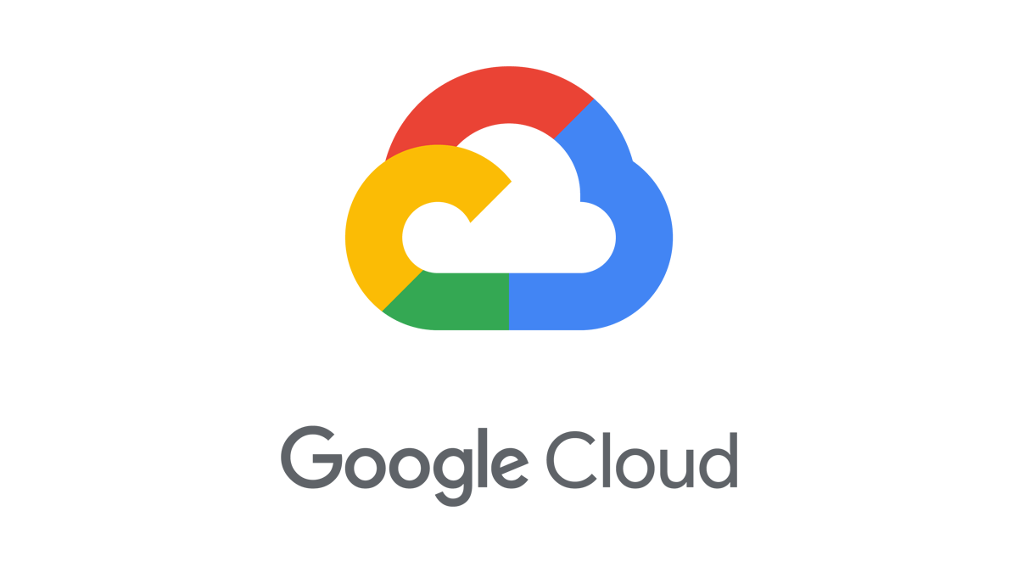
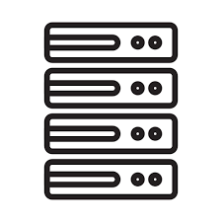



The Deployment Models of the Cloud
Private Cloud:
Cloud services used by a single organization, not exposed to the public.
Complete control
Security for sensitive applications
Meet specific business needs
Public Cloud:
Cloud resources owned and operated by a third- party cloud service provider delivered over the Internet.
Six Advantages of Cloud Computing
Hybrid Cloud:
Keep some servers on premises and extend some capabilities to the Cloud
Control over sensitive assets in your private infrastructure
Flexibility and cost- effectiveness of the public cloud

Slide 3
The Five Characteristics of Cloud Computing
On-demand self service:
Users can provision resources and use them without human interaction from the service provider
Broad network access:
Resources available over the network, and can be accessed by diverse client platforms
Multi-tenancy and resource pooling:
Multiple customers can share the same infrastructure and applications with security and privacy
Multiple customers are serviced from the same physical resources
Rapid elasticity and scalability:
Automatically and quickly acquire and dispose resources when needed
Quickly and easily scale based on demand
Measured service:
Usage is measured, users pay correctly for what they have used

Slide 4
Six Advantages of Cloud Computing
Trade capital expense (CAPEX) for operational expense (OPEX)
Pay On-Demand: don’t own hardware
Reduced Total Cost of Ownership (TCO) & Operational Expense (OPEX)
Benefit from massive economies of scale
Prices are reduced as AWS is more efficient due to large scale
Stop guessing capacity
Scale based on actual measured usage
Increase speed and agility
Stop spending money running and maintaining data centers
Go global in minutes: leverage the AWS global infrastructure

Slide 5
Problems solved by the Cloud
Flexibility: change resource types when needed
Cost-Effectiveness: pay as you go, for what you use
Scalability: accommodate larger loads by making hardware stronger or adding additional nodes
Elasticity: ability to scale out and scale-in when needed
High-availability and fault-tolerance: build across data centers
Agility: rapidly develop, test and launch software applications

Slide 6
Infrastructure as a Service (IaaS)
Platform as a Service (PaaS)
Applications
Data Runtime Middleware O/S Virtualization
Software as a Service (SaaS)
Applications
Data Runtime Middleware O/S Virtualization
On-premises
Applications
Data Runtime Middleware O/S Virtualization
Applications
Data Runtime Middleware O/S Virtualization
Servers
Storage
Servers
Storage
Servers
Storage
Servers
Storage
Networking
Networking
Networking
Networking
Managed by you
Managed by others

Slide 7
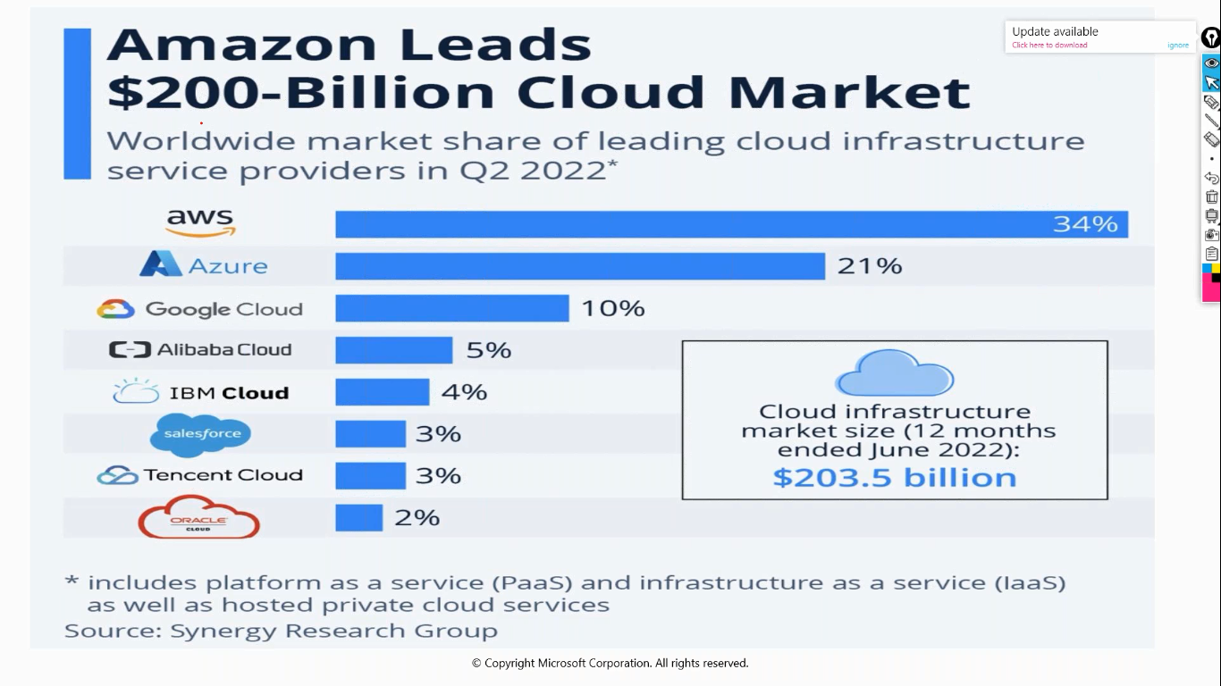

Slide 8
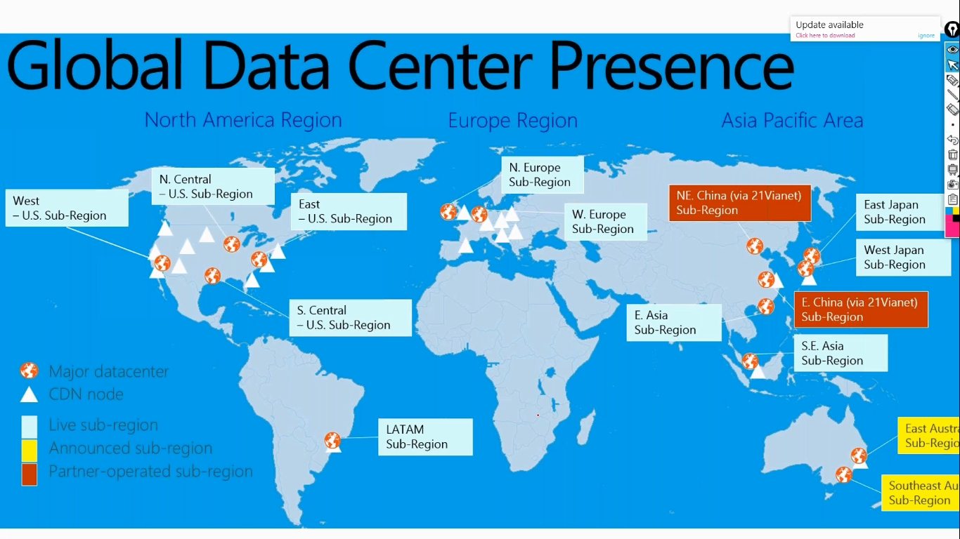

Slide 9

Any Questions ?

